Slide 1
Introduction to Info. & Comm. technologies
Course Code: CL117
Credit hours: 1

Slide 2
Introduction
Lecturer: Ms. Saba Ghani
Department of Computer Science
MSCS-FAST NUCES
BSCS-LCWU Lahore
Email: saba.ghani@nu.edu.pk

Slide 3
Course objective
This course is designed to provide an introduction to computers, information manipulation and application
The emphasis of this course is on developing basic knowledge at abstract level of different fields in computer science
Computer architecture, Mathematics in CS, Big data, Web development, Artificial intelligence, Computer Graphics
The knowledge you will gain in this course will help you in other courses at FAST

Slide 4
Course Format
Course is theoretical in nature with minimal reliance on LAB work
Alternative lectures will be followed by a graded assignment
Assignments will be both individual as well as group
Quizzes will be announced and unannounced
There will be a project at the end of the semester (done in a group of 2 students)

Slide 5
Attendance Policy
Minimum attendance required to sit in final exam is 80%
No tolerance in this limit will be offered
Proxy attendance will result in marking of absence for both the students for 3 lectures

Slide 6
Honor Code
Dishonesty will NOT be tolerated
Will result in zero marks in the corresponding work
All parties involved in any kind of cheating (in any exam) will get a zero (in that exam)

Slide 7
General Guidelines
Visit slate course folder regularly for updates
Start working on projects/assignments right from the first day
Come prepared in the class
Do not hesitate. Ask questions freely (Raise hand and wait for your turn)

Slide 8
Today’s agenda
Introduction to computers
Data & Information
Primary components
DIKW pyramid
Evolution of computers
Latest applications of computer science

Slide 9
Computer science
Study of computers and computational systems
Principal areas of study within Computer Science include artificial intelligence, computer systems and networks, security, database systems, human computer interaction, vision and graphics, numerical analysis, programming languages, software engineering
Although knowing how to program is essential to the study of computer science, it is only one element of the field
Notes:
Unlike electrical and computer engineers, computer scientists deal mostly with software and software systems; this includes their theory, design, development, and application.

Slide 10
Computer science (Cont’d)
Computer scientists design and analyze algorithms to solve programs and study the performance of computer hardware and software
The problems that computer scientists encounter range from
the abstract-- determining what problems can be solved with computers and the complexity of the algorithms that solve them
to the tangible – designing applications that perform well on handheld devices, that are easy to use, and that uphold security measures.
Notes:
Unlike electrical and computer engineers, computer scientists deal mostly with software and software systems; this includes their theory, design, development, and application.

Slide 11
Data vs Information
Data is a collection of raw facts, figures and symbols, such as numbers, words, images, video and sound
Information is data that is organized in a meaningful and useful manner
Computer takes data as input and processes it to form information

Slide 12
The dikw pyramid
The full form of DIKW Hierarchy is as below:
“D” = Data
“I” = Information
“K” = Knowledge
“W” = Wisdom
The DIKW model or DIKW pyramid is an often used method to explain the ways we move from data (the D) to information (I), knowledge (K) and wisdom (W) with a component of actions and decisions
Simply put, it’s a model to look at various ways of extracting insights and value from all sorts of data: big data, small data, smart data, fast data, slow data
Notes:
We use DIKW as one of several ways to define, illustrate and explain the various forms of data, information

Slide 13
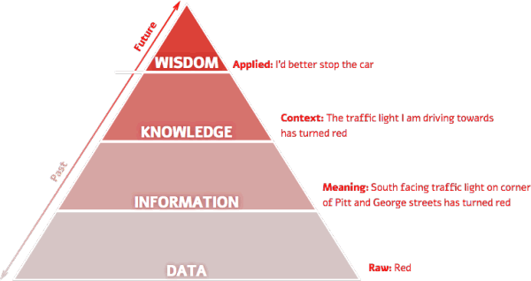
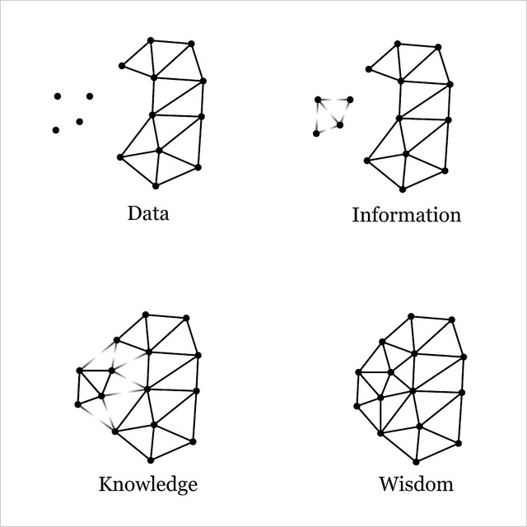
The dikw pyramid (coNT’D)

Slide 14
What is a Computer?
Computers are electronic devices that can follow instructions to accept input, process that information and produce output
Alternatively, a computer is a device capable of
performing calculations
and making logical decisions at speeds millions, and even billions, of times faster than human beings can
For example
Many of today’s Personal Computers can perform tens of millions of additions per second
A person operating a desk calculator might require decades to complete the same number of calculations a powerful personal computer can perform in one second.

Slide 15
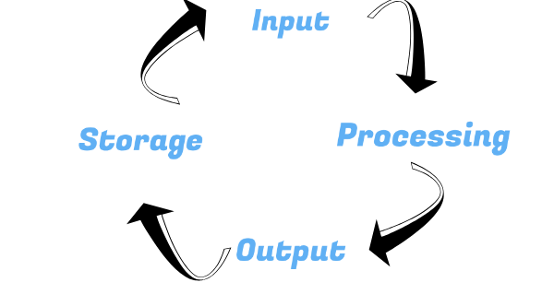
Information Processing Cycle
Computers can perform four general operations, which comprise the information processing cycle
Input – Entering data into the computer
Processing – Performing operations on the data – Software
Output – Presenting the results
Storage – Saving data, programs, or output for future use

Slide 16
How Does a Computer Know what to do?
It must be given a detailed list of instructions, called a computer program or software, that tells it exactly what to do
Before processing a specific job, the computer program corresponding to that job must be stored in memory (RAM)
Once the program is stored in memory the computer can start the operation by executing the program instructions one after the other

Slide 17
Primary Components Of A Computer
Input devices
Output devices
System unit
Central Processing Unit (containing the control unit and the arithmetic/logic unit)
Memory
Storage devices

Slide 18
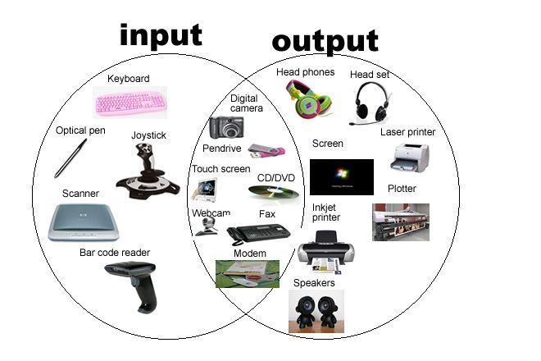
Input & output devices

Slide 19
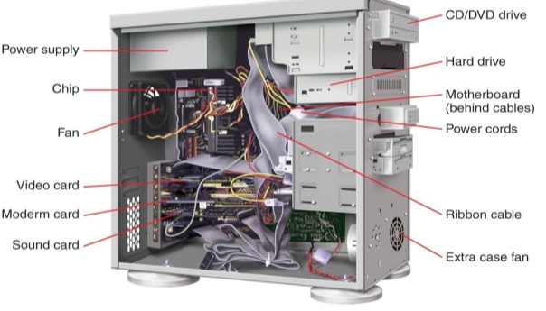
System unit
The system unit is electronic circuitry housed within the computer cabinet
The two main parts of the system unit are:
Central Processing Unit
Memory

Slide 20
Storage Devices
Used to store instructions, data, and information when they are not being used in memory
Unlike RAM, storage devices can retain data even when the computer is turned off
Data is stored “permanently”
For microcomputers, the most important kinds of secondary storage are:
Floppy Disks
Hard Disks
Optical Disks
USB drives

Slide 21
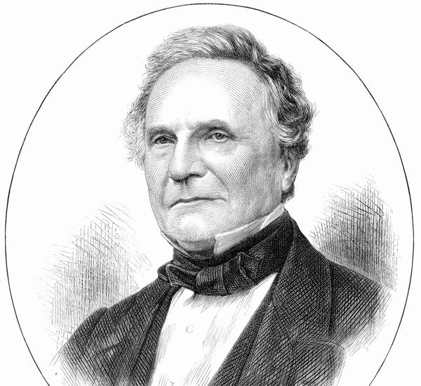
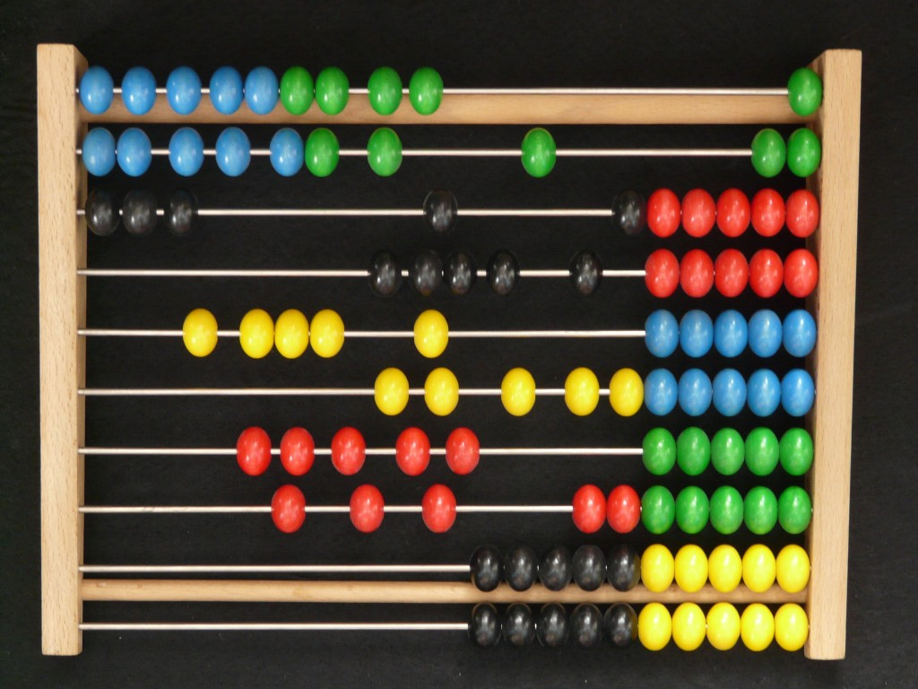
Evolution of computers
The word COMPUTER was first used in a book named as ”The Young Mans Gleanings” written by English writer Richard Braithwait
The answer to the question “Who invented the computer?” is not a simple one
"Father of Computers"- Charles Babbage
Many centuries ago when man started to count the numbers, he thought of a device which can trace the numbers and thus came the existence of ABACUS
Notes:
It was the first counting device which was developed in China more than 3000 years ago. The name Abacus was obtained from Greek word Abax which means slab. This device basically consists of a rectangular wooden frame and beads.

Slide 22
First Generation Computers
First generation computers made use of vacuum tubes
Expensive and bulky
They used machine language for computing and could solve just one problem at a time
IBM, today a big name in the list of computer technology industries, was founded in 1911
It was in 1937 that Alan Turing came up with the concept of a theoretical Turing machine
Its computations were based on a vacuum tube and it used regenerative capacitor memory
'Z Machines', especially the Z3 of 1941 was a notable achievement in the evolution of computers
It was the first machine to include binary and floating-point arithmetic
Notes:
Regenerative capacitor memory is a type of computer memory that uses the electrical property of capacitance to store the bits of data. Because the stored charge slowly leaks away, these memories must be periodically regenerated (i.e. read and rewritten, also called refreshed) to prevent data loss.

Slide 23
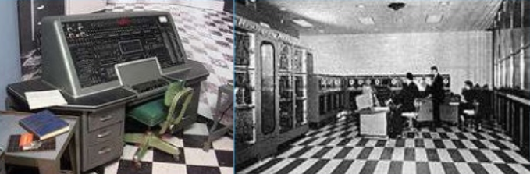
First Generation (cont’d)
The U.S. Army came up with the Electronic Numerical Integrator And Computer (ENIAC) in 1946. It came to be known as the first general purpose electronic computer
IBM announced the IBM 702 Electronic Data Processing Machine in 1953
First-generation computers cost about $1 million each to build.

Slide 24
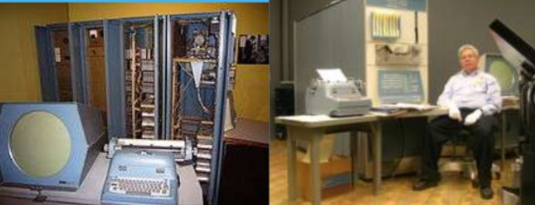
Second Generation
In the 1960s, transistor-based computers replaced vacuum tubes
Transistors made computers smaller and cheaper
They made computers energy-efficient
But transistors led to emission of large amounts of heat from the computer
Computers of this generation used punched cards for input
They used assembly language
1961: Dr. hopper was instrumental in developing the COBOL language

Slide 25
Third generation
Integrated circuits
Operating systems were the human interface to computing operations and keyboards and monitors became the input-output devices
Computer keyboards evolved from the early typewriters
The development of computer storage devices started with the invention of Floppy disks, by IBM again
In 1969, the development of ARPANET began with the financial backing of the Department Of Defense

Slide 26
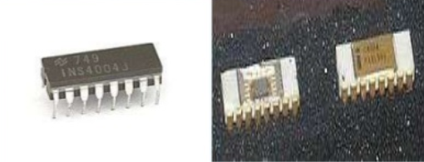
Forth generation
Thousands of integrated circuits placed onto a silicon chip made up a microprocessor
1970: Dr. Ted Hoff developed the famous Intel 4004 microprocessor (G) chip
1971: Intel released first microprocessor
Capable of processing four bits of data at a time
Included its own ALU
By 1988, more than 45 million computers were in use in the United States. The number went up to a billion by 2002

Slide 27
Fifth generation
The fifth generation computers are in their development phase
They would be capable of massive parallel processing, support voice recognition and understand natural language
Computer technology is likely to transform computing machines into intelligent ones that possess self organizing skills
The evolution of computers will continue, perhaps till the day their processing powers equal human intelligence
More user-friendly interfaces with multimedia features
Availability of very powerful and compact computers at cheaper rates

Slide 28
LATEST COMPUTER APPLICATIONS
Desktop publishing such as Microsoft word and excel
Use of computer science in education
Web surfing
Use of computer science in business
Use of computer in Hospitals and in Medical
Use of computer in the Banking sector
Use of computer in a home

Slide 29
LATEST COMPUTER APPLICATIONS (cont’d)
video and photo editing such as the adobe suite applications
Develop software such as Visual Studio
Manage networks and servers
Playing computer games
Downloading music and movies
Shopping online
Using your latest awesome cell phone
Neurotically updating your MySpace and Facebook pages and stalking other people's profiles
Traveling on an airplane
There are literally hundreds of various uses. It all depends on its functionality and purpose.

Slide 30


Slide 31
Home task
Applications of DIKW pyramid in different domains
At least five
Advancements in computer’s external/internal storage devices
Include latest till 2019
Slide 21: write the paragraph in which the word COMPUTER was first used

